Slide 1

The Modern Resume
Building Your Brand
Steve Jones
Editor, SQLServerCentral
Database Weekly
Red Gate Software
SQL Share
# 66

Slide 2



The Modern Resume
Building Your Brand
Steve Jones
Editor, SQLServerCentral
Database Weekly
Red Gate Software
SQL Share

Slide 3
Agenda
Why Build a Brand?
Practical Tips
  Social Networking
  Volunteering
  Leadership
  Blogging
  Authoring
  Speaking
Resume Tips
Recruiters

Slide 4
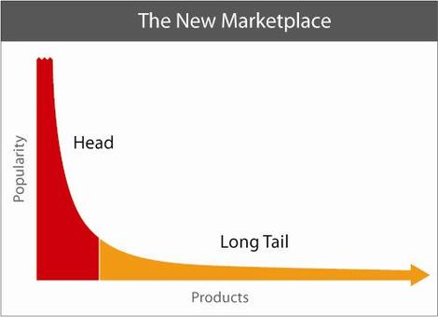
Long Tail
Notes:
Has anyone read The Long Tail? Do you know what it is? There’s this idea of niches that have value. You are a niche for your next job, or you should be. You can strive to be at the head, or the tail. Nothing wrong with tail, for the head, ping me later. For the tail, you want to move up.
Next – Wheat/Chaff

Slide 5
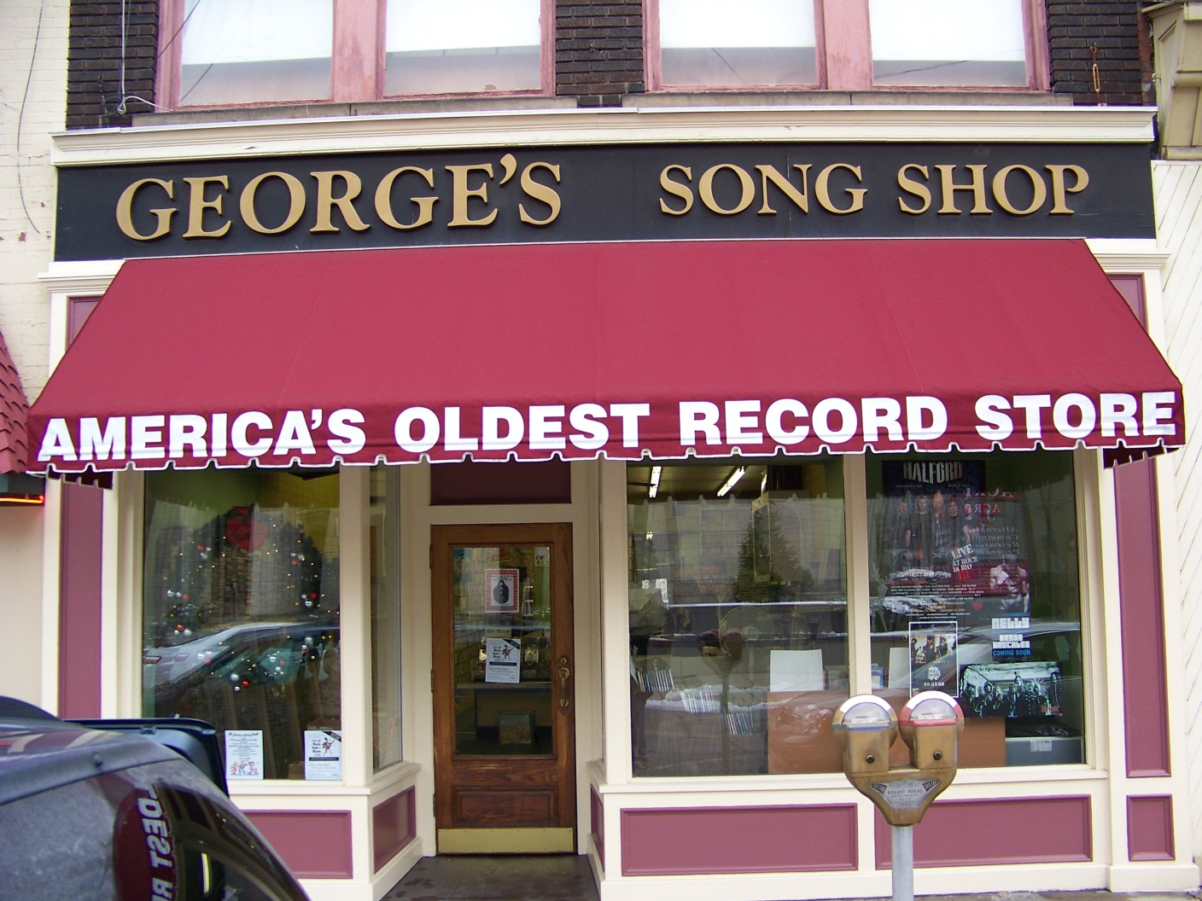

Slide 6
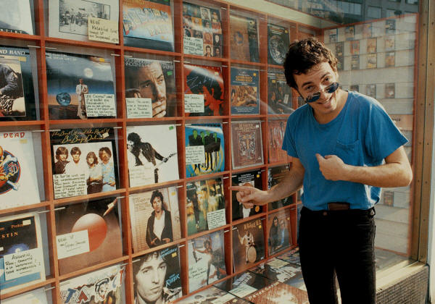

Slide 7


Slide 8
Long Tail
Employer Desire
Potential Employees
Notes:
Has anyone read The Long Tail? Do you know what it is? There’s this idea of niches that have value. You are a niche for your next job, or you should be. You can strive to be at the head, or the tail. Nothing wrong with tail, for the head, ping me later. For the tail, you want to move up.
Next – Wheat/Chaff

Slide 9

Long Tail
Employer Desire
Potential Employees
Notes:
Has anyone read The Long Tail? Do you know what it is? There’s this idea of niches that have value. You are a niche for your next job, or you should be. You can strive to be at the head, or the tail. Nothing wrong with tail, for the head, ping me later. For the tail, you want to move up.
Next – Wheat/Chaff

Slide 10

Long Tail
Employer Desire
Potential Employees
Notes:
Has anyone read The Long Tail? Do you know what it is? There’s this idea of niches that have value. You are a niche for your next job, or you should be. You can strive to be at the head, or the tail. Nothing wrong with tail, for the head, ping me later. For the tail, you want to move up.
Next – Wheat/Chaff

Slide 11

Long Tail
Employer Desire
Potential Employees
Notes:
Has anyone read The Long Tail? Do you know what it is? There’s this idea of niches that have value. You are a niche for your next job, or you should be. You can strive to be at the head, or the tail. Nothing wrong with tail, for the head, ping me later. For the tail, you want to move up.
Next – Wheat/Chaff

Slide 12


Notes:
Know what this is? Wheat and chaff. When you harvest, you get everything, but then you need to separate things out and get the grain. Get what you want. You want to get separated for the position that is right for you, or that you want.
In other words – (Next umbrella)

Slide 13

Notes:
Stand out of the crowd.
Next – How to stand out

Slide 14
Standing Out
Humility is good
Except
  When looking for a job
  Trying to get a promotion
  Trying to keep a job

Slide 15

Notes:
Be careful as you move forward (next CareerBuilder)

Slide 16
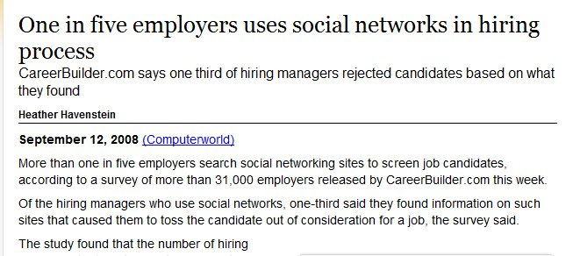
Notes:
People will look for you (next trip ups)

Slide 17

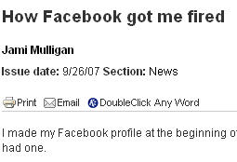
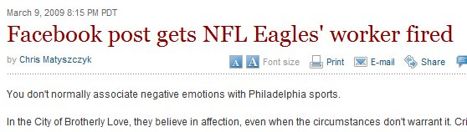
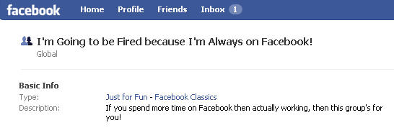
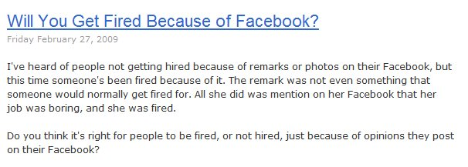
Notes:
Bad profiles
Emabaress MS, get fired (picture of Mac on loading dock)
Too much time on networking
Concept of privacy
It’s not big brother, it’s older brother.
(next Image is Everything)

Slide 18
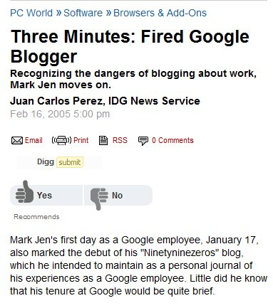


Slide 19
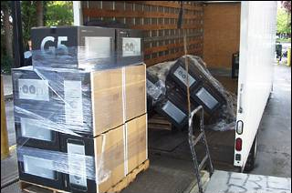

Slide 20
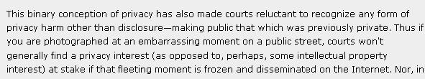
Courts won’t generally find a privacy interest

Slide 21
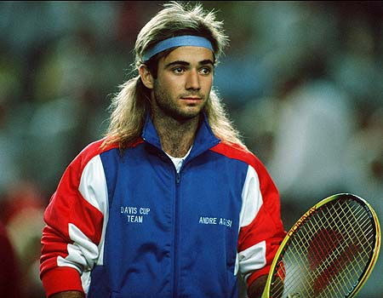
Image is Everything
Not Everything, but it does matter
Notes:
Next – online profiles

Slide 22
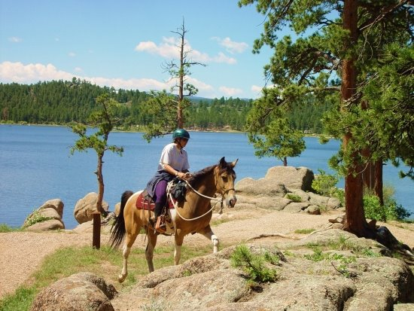

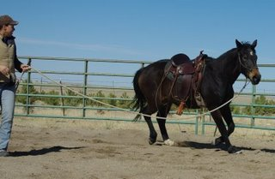

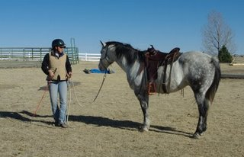

Slide 23
How to stand out?
Resume
Profiles
Networking
Volunteer
Research
Be a Leader
Blog
Publish
Speak
Can be Internal or External
Notes:
Various ways, important thing (Click) these can be external or internal to your job. External meaning out in public, internal, behind the firewall.
Next - Caution

Slide 24
Resumes
1-2 pages (resume)
  CV may be longer
Keywords at the end
Make the resume human readable
Include branding links
  To blog or promotional posts
  Online profile
Be professional
  Be relevant
  Don’t be funny
    Weird Things on Resumes
Notes:
Weird things
Pig wrestling champion
Cooks Exotic meats
Good things
- gold medalist
- lead in local theater

Slide 25
Cover Letters
This is the first impression
  This is a pre-interview
Customize for each company
  How to write one?
    Google search
    Practice
  How not to write one?
    http://www.bradmcgehee.com/2010/03/how-not-to-write-a-resume-cover-letter/

Slide 26
Online Profiles
A digital representation of who you are
The details of your career
  A central repository of your work
  A portfolio for clients
  Tie together the various places where you have a presence.
Online Resume
  Can be a summary
  This can be your CV as well
  Include the information that has “rolled off” your resume.
Notes:
CareerBuilder says 22% of hiring managers search for an online profile.
You want to manage your profile. Not lie, but disclose and show yourself off. (pager story)
Anyone can create one for you. Watch for your profile online. Especially if you have had issues. Don’t create one.
Washington Post or Kids test. If you wouldn’t want them to see it, don’t put it up there.
Next - Leadership

Slide 27
Online Profiles
Give “them” one
  They’ll find one anyway
Be prepared to explain any you have created
  And maybe some you haven’t
Be professional
  You can have fun, but keep it separate
  ALL your actions reflect on you, remember that.
  Use “THE Test”
Notes:
CareerBuilder says 22% of hiring managers search for an online profile.
You want to manage your profile. Not lie, but disclose and show yourself off. (pager story)
Anyone can create one for you. Watch for your profile online. Especially if you have had issues. Don’t create one.
Washington Post or Kids test. If you wouldn’t want them to see it, don’t put it up there.
Next - Leadership

Slide 28
Online Profiles
Building an online profile
  Your Web site
  Facebook
  LinkedIn
  Plaxo
  MySpace
  Twitter
  Blogger/Wordpad/Typepress/other
Include Contact Information
  Avoid Identity Information
Keep this professional
  Use another profile for personal information
Notes:
CareerBuilder says 22% of hiring managers search for an online profile.
You want to manage your profile. Not lie, but disclose and show yourself off. (pager story)
Anyone can create one for you. Watch for your profile online. Especially if you have had issues. Don’t create one.
Washington Post or Kids test. If you wouldn’t want them to see it, don’t put it up there.
Next - Leadership

Slide 29
Online Profiles
Google Alerts
  Monitor what is being posted about you
Have this profile ready at all times
  This can be the first place you point people
Update this quarterly as your career advances
Summarize all your accomplishments in one place
Notes:
CareerBuilder says 22% of hiring managers search for an online profile.
You want to manage your profile. Not lie, but disclose and show yourself off. (pager story)
Anyone can create one for you. Watch for your profile online. Especially if you have had issues. Don’t create one.
Washington Post or Kids test. If you wouldn’t want them to see it, don’t put it up there.
Next - Leadership

Slide 30
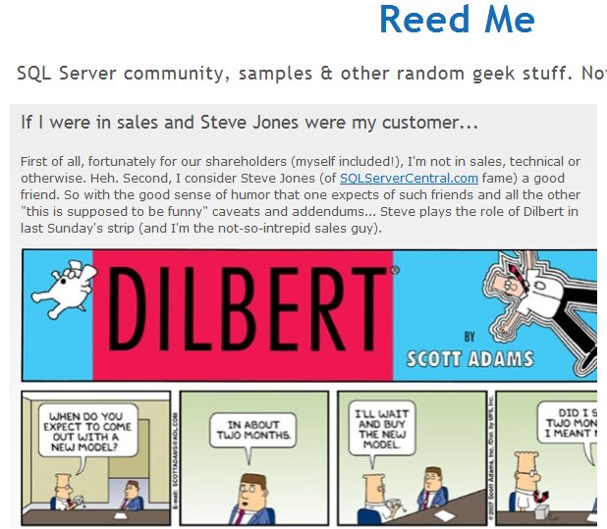
Notes:
Not a bad joke, but I wasn’t aware this was posted until someone told me. It could have been something that I would have been upset about, and while you can’t do anything about it, you can help to explain it if you are aware of it.

Slide 31





Social Networking
?
Notes:
Survey, count members of each
Next - Authors

Slide 32
Social Networking
Web 2.0 / Social Networking
No different from the real world
  Chamber of commerce
  User groups
  BBB
In today’s world, the online world can take the place of these offline events.
You can still participate in offline events
  Use online tools to help reinforce your offline efforts.
Notes:
Building an online network is a no different than networking in the real world. Chamber of Commerce or BB meetings, user groups, other business associations, all had happy hours or other ways for people to connect with each other, get to know each other professionally, and create opportunities.
This is the modern “golf course”

Slide 33
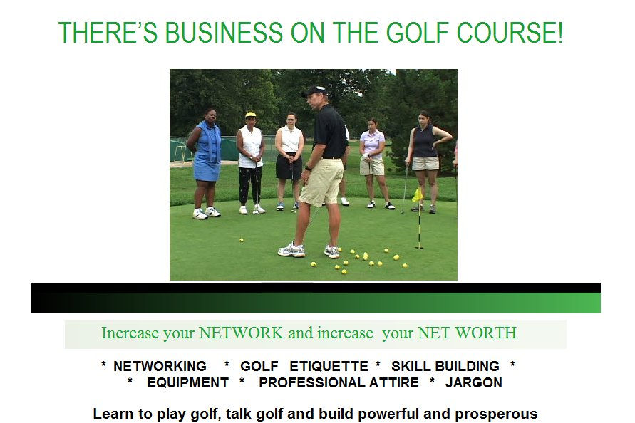
Notes:
This is the modern golf course. How many deals have puzzled you in business? How many times have you suggested that your boss chose a vendor over a game of golf, a dinner, or some other event. Business is involved with relationships between people. Social networking can help you expand those reaches.

Slide 34
Networking
Online tools give you a way to network with other professionals
  Bonding
  Sharing
A way to let others know about you
  What you are engaged in
  Your current status
A way to hear about
  Opportunities
Notes:
Building an online profile is a no different than things done in the past in the real world. Chamber of Commerce or BB meetings, user groups, other business associations, all had happy hours or other ways for people to connect with each other, get to know each other professionally, and create opportunities.
This is the modern “golf course”

Slide 35
Networking
You’ve signed up, now what?
Interact with others
  Ask questions
  Post comments in your work, of your learning
  Survey others for their thoughts
  Get inspired
Notes:
When you have signed up, now interact. Just like being at any event in the real world, you need to participate.

Slide 36
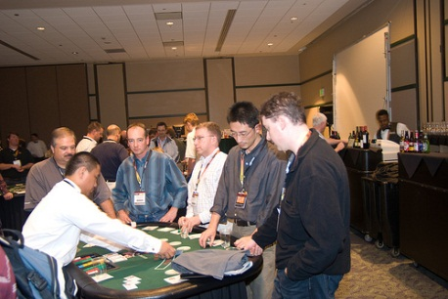
Notes:
Get to know people.

Slide 37
Social Networking
Avoid identity information
  Check with your family
Keep these interactions professional
  Use another account for personal information (usually)
Use an email that you can monitor.
Update this on a regular basis
  Use this to interact with others
  Every 2-4 weeks
Get email updates on a reasonable schedule
Notes:
Be careful what you post up there. Post contact information, but be careful about identity information. Make sure your family knows what you post, and use an email that allows people to get in touch with you, and helps to keep you involved.

Slide 38
Volunteer
PASS/Local Group
  Be sincere
  Be sure your name is out there
  Document efforts
Work
  Tackle something that needs to be done
  Be sure this is noted somewhere, like the intranet, company newsletter, etc.
  Keep a record for your review.
Notes:
Volunteering gives back to the world. It shows that you are willing to do more than just your job. If you do career oriented volunteering, that shows that you are willing to help others in your field. You would be someone that is willing to help others, without being told to do so.

Slide 39
Volunteer
Forums
  Help others by answering questions
  Pay it forward
  Force yourself to learn more/check yourself
  Note your username on your resume
Build a Project (Codeplex)
Non-Profit Organizations
  Could be technical or nontechnical
Don’t volunteer unless you want to
Notes:
Forums show that not only are you willing to help, but you have knowledge.

Slide 40
Research
Ask questions your online
  Can be added to your blog
  Show some back story, thought process, some effort being made
  Shows you are learning and unafraid to ask for help.
  Shows that you know how to find help
    This can be useful in an interview
Notes:
Ask your own questions online. As you learn something, put it back out there. Give the back story, the why, the how, the what you learned, or the how it helped you.
This shows you are working on your own career and knowledge. Both to your current boss and potential future ones.

Slide 41
Leadership
Everyone needs leaders
Leader != Manager
  But it helps
You can be
  Project leader
  Organization leader
  Thought leader
This does not have to be in technology!
  Document your efforts
Notes:
Leadership helps you stand out.
This is not a manager, though it can be. And that helps.
Project leader – On some task, provide coordination, direction, ideas
Organization – Can be internal or external, formal or informal.
Thought – Just express yourself. You can be someone that people follow, or maybe counsel
Next - blogging

Slide 42
Blog Survey
Who has a technical blog?
Who reads technical blogs regularly?

Slide 43
Blog Survey
Who has a technical blog?
Who reads technical blogs regularly?
10% have technical blogs
80% read blogs
Notes:
More people read, few people write. This builds communication skills, and shows off your knowledge.

Slide 44
Blogging
A chronicle
This is a your voice
Write about what you
  Learn
  Know
  Solve
  Do
  Think
Notes:
This is your chance to show off what you know.

Slide 45
Blogging
Don’t overthink it.
Tackle small, discrete items
Ignore similar posts
Remember this is about YOU!
  Building a publishing platform is a different type of blog. You can do this, but you do not have to.
A long term chronicle of your career.
Keep this blog professional
  Relate it to your career
Notes:
Examples: backups fail, trying to explain why log restores needed.
Issues with working over the phone
disconnect with developers, manager
Going to work late, after hours
Organization of files
impact to organization, what I could minimize in the future.
Building a Report
Request comes in, how you analyze the request and get more information
Structuring this report to meet needs, decisions taken
Writing queries, simple, complex, how the query translates into the business need, planning for future changes, tuning, looking at indexes
New Report
New person? How are they different. Same person, has it gotten better
Checking for similar reports, looking for reuse
New tools/features
Next - Publishing

Slide 46
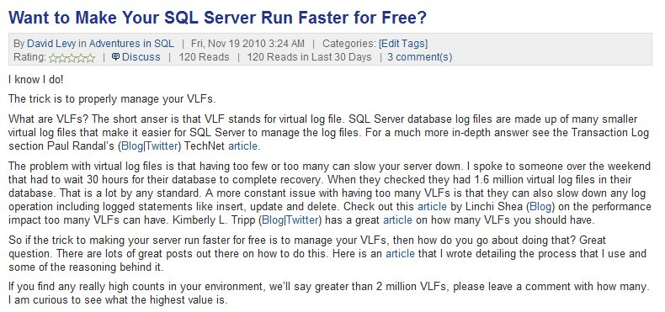
Example
http://www.sqlservercentral.com/blogs/adventuresinsql/archive/2010/11/19/want-to-make-your-sql-server-run-faster-for-free_3F00_.aspx

Slide 47
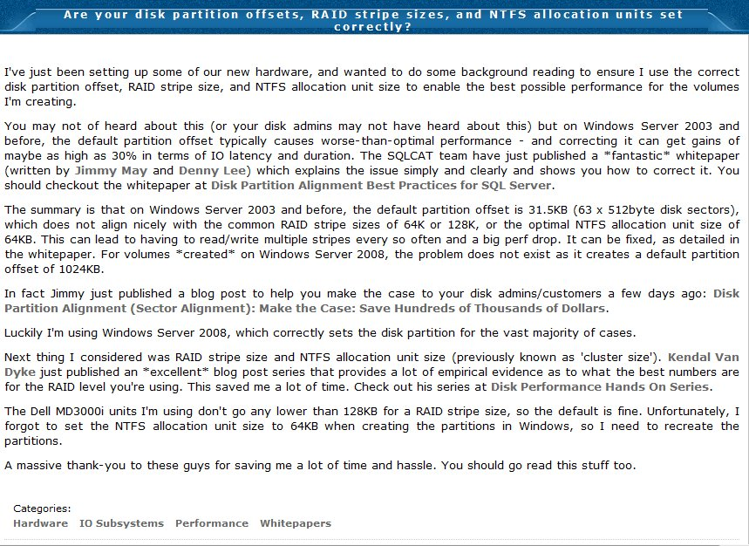
Example
http://www.sqlskills.com/BLOGS/PAUL/post/Are-your-disk-partition-offsets-RAID-stripe-sizes-and-NTFS-allocation-units-set-correctly.aspx

Slide 48
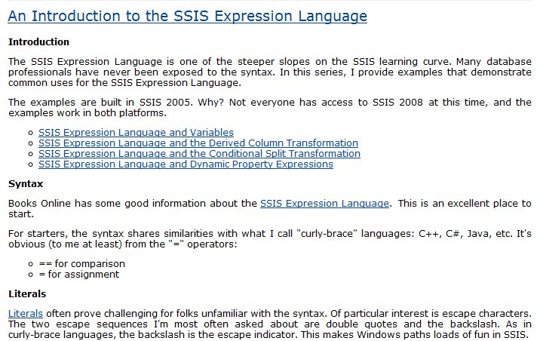
Example
http://sqlblog.com/blogs/andy_leonard/archive/2009/01/30/an-introduction-to-the-ssis-expression-language.aspx

Slide 49
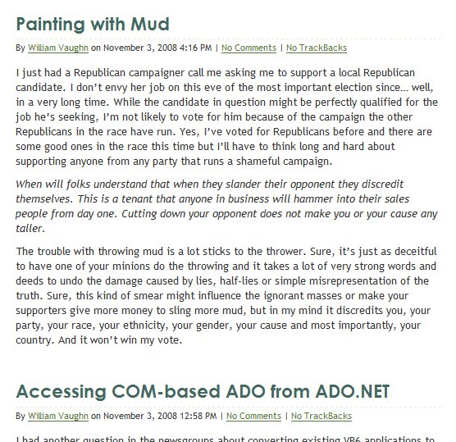
A Mistake
Politics
Development

Slide 50
How to blog
Get Permission
Be smart
  Don’t disclose financial information
  Keep company secrets secret
Be consistent
  Pipeline and schedule
  Be clear
  A survey of hiring managers showed they tend to look at 5-10 posts.
Notes:
Ask your boss, set rules, keep it simple
Don’t do anything that you wouldn’t want done to you
Get ahead of the curve and make this a regular occurrence. Choose a reasonable schedule. I’d say once every other week at a minimum, set reminders in Outlook.
If you have nothing interesting, write that. IF that happens too often, think about that as well. Time for a new job
Imagine you’re writing for a jr DBA or new guy in your position, explain things clearly. Don’t assume too much (may vary for internal blogging)
Big internal bloggers: Andy Grove – Intel,
Next – Blogging Ideas

Slide 51
How to blog
Don’t copy other posts
Don’t copy other posts
Don’t copy other posts
Do your own research
Link to others and give credit
Keep a record
  Use Blogger/Word Press/Typepad
  Use Word if you want more privacy
Live Writer is great
Notes:
Ask your boss, set rules, keep it simple
Don’t do anything that you wouldn’t want done to you
Get ahead of the curve and make this a regular occurrence. Choose a reasonable schedule. I’d say once every other week at a minimum, set reminders in Outlook.
If you have nothing interesting, write that. IF that happens too often, think about that as well. Time for a new job
Imagine you’re writing for a jr or new guy in your position, explain things clearly. Don’t assume too much (may vary for internal blogging)
Big internal bloggers: Andy Grove – Intel,
Next – Blogging Ideas

Slide 52
Authoring / Publishing
Become a teacher
Think “Essay”
  Focus, focus, focus
Don’t be intimidated
More formal writing and editing required.
  This is a step above blogging.
Notes:
1 - Print is still good, and it’s exciting, but it’s not necessary. Big time investment, more of a “head of the tail” not “Tail of the tail” idea.
Lulu – Vanity if you really want to)
2 - As you try to write online, think of writing an essay
Focus on one thing. Don’t try to solve all issues. Don’t get carried away with setup. Andy as example
3 - If you’ve solved it, there might be 1,000 people that have, but likely 5,000 that haven’t.
Next - Volunteer

Slide 53
Authoring / Publishing
Different choices
  SQLServerCentral.com
  SQLTeam.com
  Simple-Talk.com
  SQL-Server-Performance.com
  SQL Server Magazine
.NET
  Simple Talk
  Visual Studio Magazine
Notes:
1 - Print is still good, and it’s exciting, but it’s not necessary. Big time investment, more of a “head of the tail” not “Tail of the tail” idea.
Lulu – Vanity if you really want to)
2 - As you try to write online, think of writing an essay
Focus on one thing. Don’t try to solve all issues. Don’t get carried away with setup. Andy as example
3 - If you’ve solved it, there might be 1,000 people that have, but likely 5,000 that haven’t.
Next - Volunteer

Slide 54
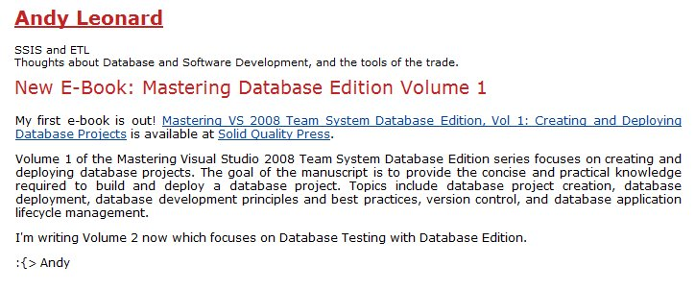
Books
Long projects
  Don’t start here. Get practice with articles or lots of blogs
Lots of authors subcontract out
  Social networking can help you find these
Promote it

Slide 55
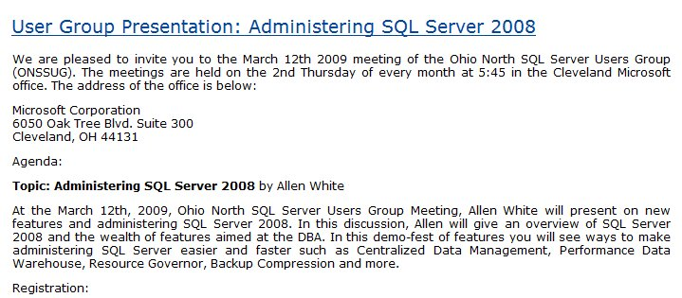
Speaking
Everyone can do this
Offline efforts
Promote it online
  Market on your blog (or others)
  Support with downloads
  Make sure there is a permanent URL

Slide 56

Documentation
Document everything.
  Never know when you’ll need something
Don’t clutter your resume
  But have links available
  Or have an online CV
Document mistakes
  Let them know you’re not that guy:
Notes:
1 – keep track of what you do. Use Gmail/Hotmail, forward your blogs. Know what you’ve done. It helps you track your data shadow. Know what you wish you hadn’t as well.
2 – Keep your resume simple. Even in this day of electronics, go with 2 pages, no more. After 2-3 jobs, summarize to 2 lines, link to other things. A CV, complete history isn’t a bad idea.
3 – Find out what is wrong in your data shadow. Know what’s out there and have a reason, admit mistakes (know what you learned) and also be sure you know where confusion lies.
Next – End

Slide 57
Recruiters
A great source for you job hunt
Many jobs go through recruiters
Non-Exclusive
Make sure they have you branding information in a profile

Slide 58
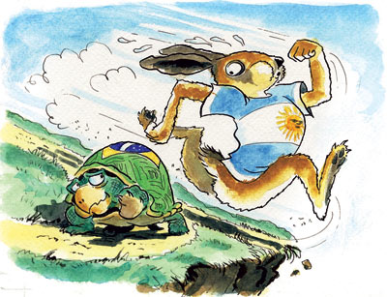
Balance
You can have a life and still do this
Work at a pace that fits your life. The key is to keep working.
Notes:
You can still have a life while you grow your brand. The key is to find some balance. Work a little less, or shift work, make this a hobby. Work at a pace you can handle. Remember this story? Who won? Steady work can build a brand.

Slide 59
Links
The Modern Resume blog – Weekly notes based on this presentation and new information.
Salary Negotiation: 32 Job Pay Tips - Focuses the job negotiation lens on the 32 salary negotiation tips for IT professionals. Includes exercises and questions to assist in preparation.
Examples of Interview Questions – Good general list of questions
The First Step is to Start – Motivational post .

Slide 60


The End
Touch your resume every quarter
If you find something that works, send me a note
Set a reminder for 6 months from today and look back
Questions?
Career Forums at www.sqlservercentral.com/forums
www.themodernresume.com
# 66

Slide 61
Thank you and Feedback
Thank you for attending The Modern Resume at SQL Saturday #66
Please make sure to fill out the session evaluation and place it in the box in the back of the room
# 66

Slide 62



Brad McGehee’s
SQL Server Stumpers
"You can have an unlimited number of clustered indexes on a table."
True or False?

Slide 63


Did you know?
"SQL Compare can find differences between your source control scripts and a live database. "
Elliot Matthew Red Gate Software

Slide 64
Brad McGehee’s
SQL Server Stumpers
"You can have an unlimited number of clustered indexes on a table."
False!

Slide 65


The Exceptional DBA
Awards
"The awards will give an exceptional DBA some much-deserved recognition and help to increase the awareness of the importance of the DBA role among the IT community."
Brad McGehee Exceptional DBA Awards Judge
SPONSORED BY

Slide 66
Brad McGehee’s
SQL Server Stumpers
"If the SQL Server Browser Service is not running, you cannot connect to a named instance by name."
True or False?

Slide 67


Did you know?
"Network resilience in SQL Backup Pro lets you create robust and resilient backups by resuming backup operations that have been interrupted by network outages."
Nigel Morse Red Gate Software

Slide 68
Brad McGehee’s
SQL Server Stumpers
"If the SQL Server Browser Service is not running, you cannot connect to a named instance by name."
True!

Slide 69

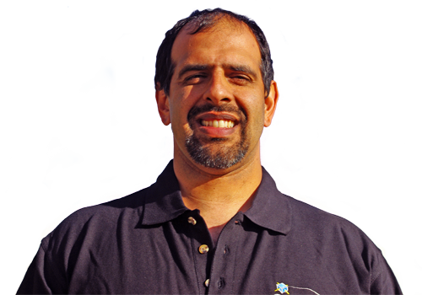
Did you know?
SQL Server Central has highly active forums, where you can get a response to a question on SQL Server and other topics in a matter of minutes.

Slide 70
Brad McGehee’s
SQL Server Stumpers
"A full database backup truncates the log when the database recovery mode is set to FULL or BULK LOGGED."
True or False?

Slide 71


Did you know?
"SQL Response sends you alerts and recommendations about the health and activity of your SQL Servers, so you can work proactively to minimize problems."
David Connell Red Gate Software

Slide 72
Brad McGehee’s
SQL Server Stumpers
"A full database backup truncates the log when the database recovery mode is set to FULL or BULK LOGGED."
False!

Slide 73


Did you know?
Simple-Talk.com has a wealth of articles written by industry experts on SQL Server, .NET and SysAdmin, with no registration required to access each article.

Slide 74
Brad McGehee’s
SQL Server Stumpers
"After updating the fragmentation of an index using ALTER INDEX REBUILD you don't need to update the statistics."
True or False?

Slide 75


Did you know?
"SQL Prompt simply sits behind the scenes and provides unobtrusive help when you press CTRL+SPACEBAR or when you type "." after a table/view/alias name. "
Simon Galbraith Red Gate Software

Slide 76
Brad McGehee’s
SQL Server Stumpers
"After updating the fragmentation of an index using ALTER INDEX REBUILD you don't need to update the statistics."
True!

Slide 77
Did you know?
"SQL Compare can find differences between your source control scripts and a live database. "
Elliot Matthew Red Gate Software

Slide 78
Brad McGehee’s
SQL Server Stumpers
"SQL Server automatically creates statistics on an index and it is impossible to turn that feature off."
True or False?

Slide 79


Did you know?
"The Outlook Add-ins for Exchange Server Archiver deliver a truly 100% transparent
end-user experience "
Chris Bacon Red Gate Software

Slide 80
Brad McGehee’s
SQL Server Stumpers
"SQL Server automatically creates statistics on an index and it is impossible to turn that feature off."
True!

Slide 81
Did you know?
"Network resilience in SQL Backup Pro lets you create robust and resilient backups by resuming backup operations that have been interrupted by network outages."
Nigel Morse Red Gate Software

Slide 82
Brad McGehee’s
SQL Server Stumpers
“Certificates can be used to only encrypt other keys (symmetric or asymmetric).
True or False?

Slide 83


Did you know?
"ANTS Performance Profiler shows you line-level code timings, so you can drill down to the specific lines of code responsible for performance inefficiencies. "
Bart Read Red Gate Software

Slide 84
Brad McGehee’s
SQL Server Stumpers
“Certificates can be used to encrypt data or other keys."
False!

Slide 85
Did you know?
SQL Server Central has highly active forums, where you can get a response to a question on SQL Server and other topics in a matter of minutes.

Slide 86
Brad McGehee’s
SQL Server Stumpers
“In SQL Server 2008, you can mirror a database set to compatibility mode 90.”
True or False?

Slide 87
The Exceptional DBA
Awards
"The awards will give an exceptional DBA some much-deserved recognition and help to increase the awareness of the importance of the DBA role among the IT community."
Brad McGehee Exceptional DBA Awards Judge
SPONSORED BY

Slide 88
Brad McGehee’s
SQL Server Stumpers
“Database Mirroring does not check the compatibility mode. It will mirror a database at any level."
True!

Slide 89
Did you know?
Simple-Talk.com has a wealth of articles written by industry experts on SQL Server, .NET and SysAdmin, with no registration required to access each article.

Slide 90
Brad McGehee’s
SQL Server Stumpers
“All page types can be restored with the single page restore option.”
True or False?

Slide 91
Did you know?
"SQL Compare can find differences between your source control scripts and a live database. "
Elliot Matthew Red Gate Software

Slide 92
Brad McGehee’s
SQL Server Stumpers
“While data pages can be restored with the single page restore feature, the file header pages, boot page, GAM, SGAM, Diff map and ML maps cannot be restored."
False!

Slide 93
The Exceptional DBA
Awards
"The awards will give an exceptional DBA some much-deserved recognition and help to increase the awareness of the importance of the DBA role among the IT community."
Brad McGehee Exceptional DBA Awards Judge
SPONSORED BY

Slide 94
Brad McGehee’s
SQL Server Stumpers
“SELECT 6 | 7 returns 7.”
True or False?

Slide 95
Did you know?
"ANTS Performance Profiler shows you line-level code timings, so you can drill down to the specific lines of code responsible for performance inefficiencies. "
Bart Read Red Gate Software

Slide 96
Brad McGehee’s
SQL Server Stumpers
“SELECT 6 | 7 is an inclusive OR operation, which will return 7.
6 = 0110
7 = 0111
The OR result is 0111.”
"
True!

Slide 97
The Exceptional DBA
Awards
"The awards will give an exceptional DBA some much-deserved recognition and help to increase the awareness of the importance of the DBA role among the IT community."
Brad McGehee Exceptional DBA Awards Judge
SPONSORED BY

